Slide 1
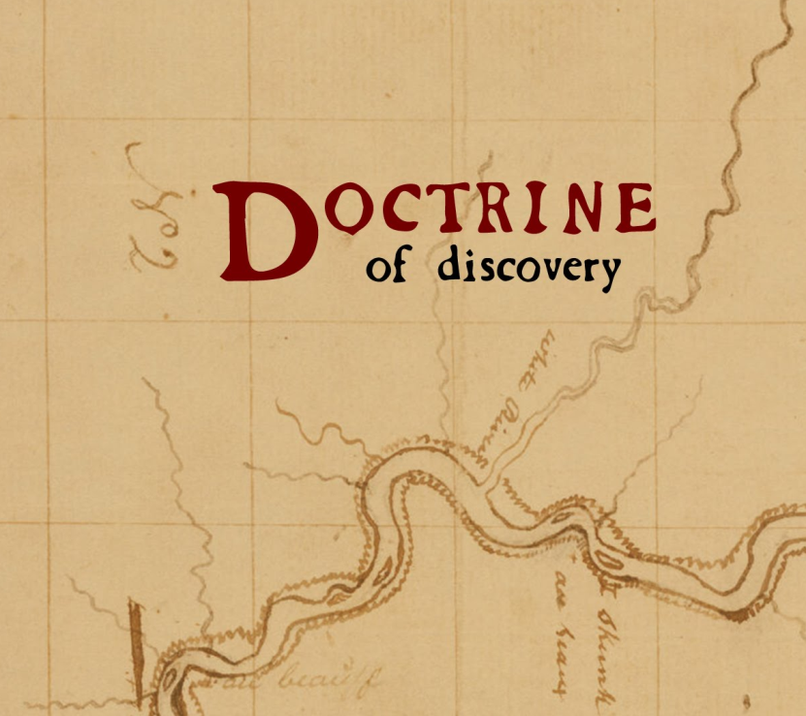
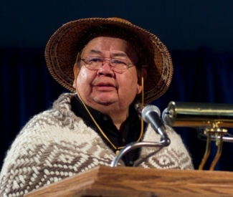
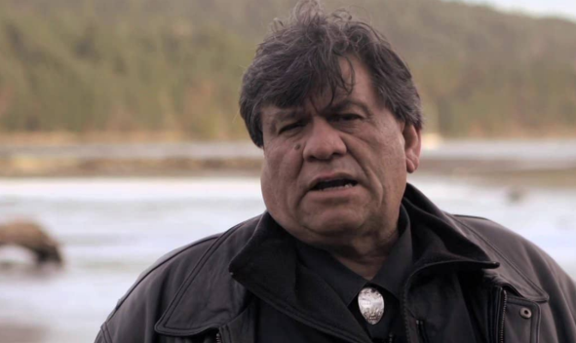
Why did Canada’s Truth & Reconciliation Commission call on churches to repudiate the “Doctrine of Discovery”?
Seenupin, Chief Andy Thomas,
hereditary chief, Esquimalt
First Nation will open the event.
Watch a 43-minute film about the 15th century Doctrine of Discovery & how it affects the world’s Indigenous Peoples.
Hear noted lawyer, Robert Morales, explain how the Doctrine of Discovery gave legal cover to a massive century-old corporate land grab on Vancouver Island.
Discussion follows.
Tuesday 4 Oct 2016
7:30-9:30 pm
Emmanuel Baptist Church
2121 Cedar Hill Cross Road
Victoria, BC
Everyone welcome. No charge.

